Slide 1
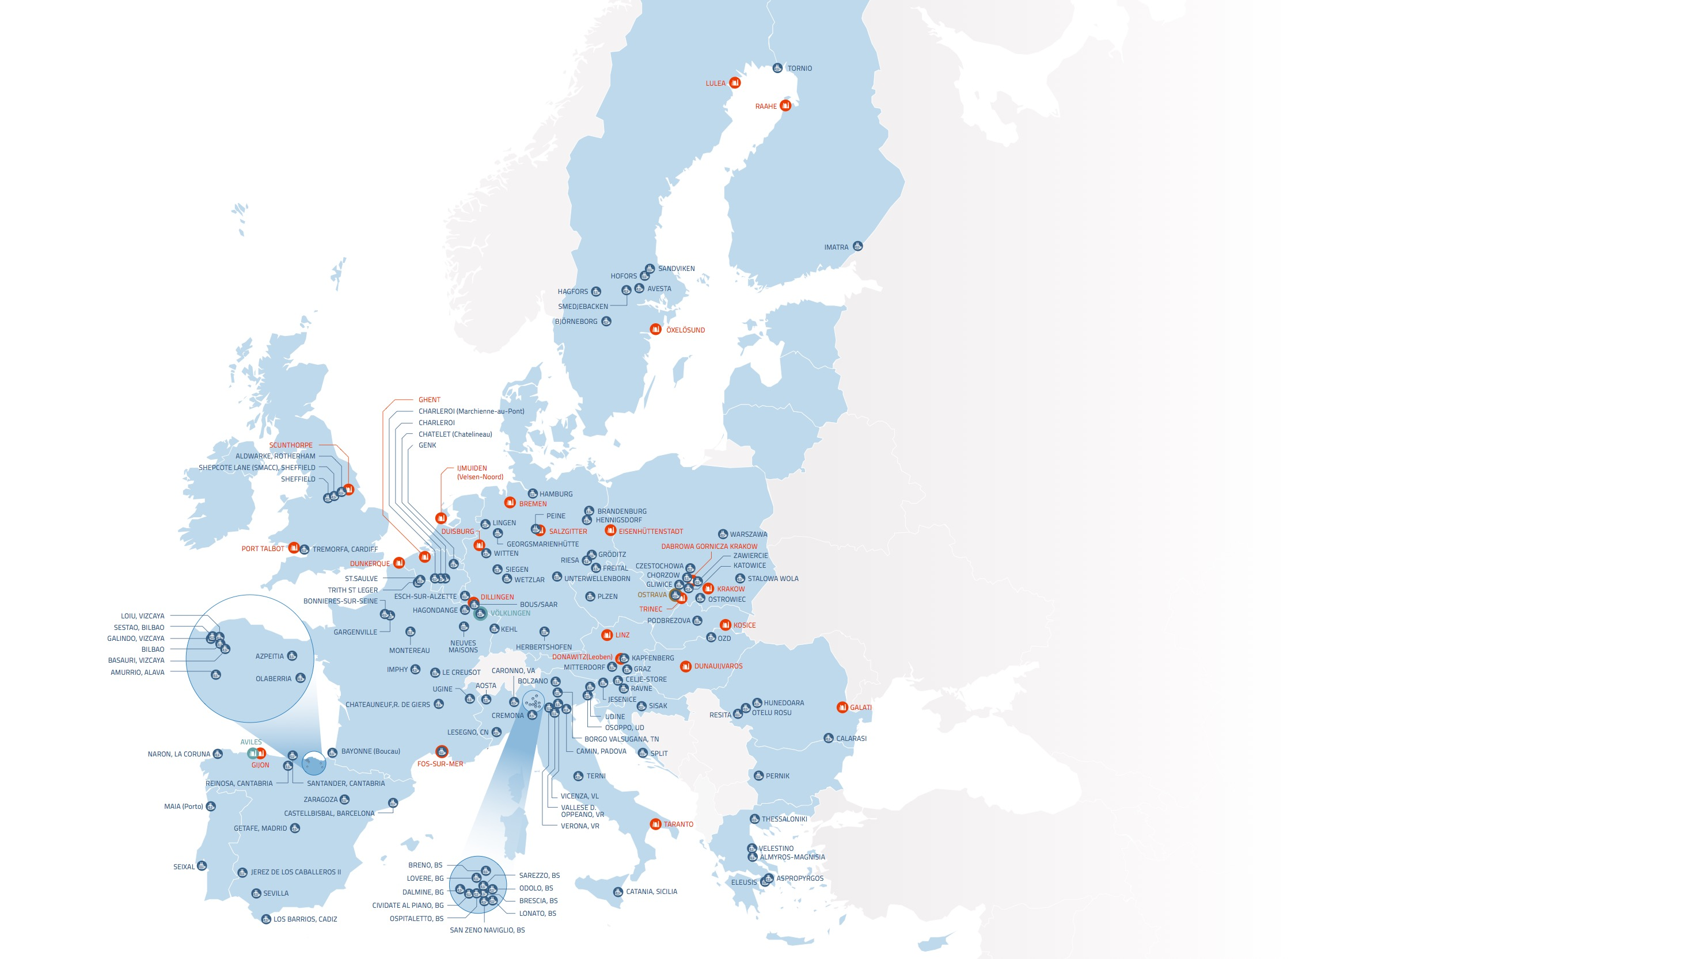
Map of EU steel production sites
Blast Furnace &
Basic Oxygen Furnace
Electric Arc Furnace
Location | Hot Metal Capacity ('000 tonnes/ year) | Finished Steel Capacity ('000 tonnes/ year) | No. of furnaces
AUSTRIA
DONAWITZ (Leoben) | 1370 | 1570 | 2
LINZ | 4340 | 6000 | 3
BELGIUM
GHENT | 4430 | 5000 | 2
CZECH REPUBLIC
OSTRAVA | 3200 |  | 3 – BF only
TRINEC | 2100 | 2400 | 2
FINLAND
RAAHE | 2400 | 2600 | 2
FRANCE
DUNKERQUE | 6800 | 6750 | 3
FOS-SUR-MER | 5160 | 5100 | 2
GERMANY
BREMEN | 3960 | 3800 | 2
DILLINGEN | 4790 | 2760 | 2
DUISBURG | 11600 | 11560 | 4
EISENHÜTTENSTADT | 2340 | 2400 | 2
SALZGITTER | 4800 | 5200 | 3
VÖLKLINGEN |  | 3240 | BOF only
HUNGARY
DUNAUIJVAROS | 1310 | 1650 | 2
ITALY
TARANTO | 9590 | 11500 | 4
NETHERLANDS
IJMUIDEN (Velsen-Noord) | 6310 | 7500 | 2
POLAND
DABROWA GORNICZA | 4500 | 5000 | 2
KRAKOW | 1310 | 2600 | 1
ROMANIA
GALATI | 3250 | 3200 | 2
SLOVAKIA
KOSICE | 2850 | 4500 | 2
SPAIN
AVILES |  | 4200 | BOF only
GIJON | 4480 | 1200 | 2
SWEDEN
LULEA | 2200 | 2200 | 1
ÖXELÖSUND | 1800 | 1700 | 2
UNITED KINGDOM
PORT TALBOT | 4770 | 4900 | 2
SCUNTHORPE | 3590 | 3200 | 3
Location | Capacity ('000 tonnes/ year) | No. of furnaces
AUSTRIA
GRAZ | 365 | 1
KAPFENBERG | 180 | 1
MITTERDORF | 300 | 1
BELGIUM
CHARLEROI | 850 | 1
CHARLEROI (Marchienne-au-Pont) | 350 | 1
CHATELET (Chatelineau) | 1000 | 1
GENK | 1200 | 2
BULGARIA
PERNIK | 1000 | 2
CROATIA
SISAK | 350 | 1
SPLIT | 185 | 1
CZECH REPUBLIC
OSTRAVA | 120 | 1
PLZEN | 150 | 2
FINLAND
IMATRA | 360 | 1
TORNIO | 1300 | 2
FRANCE
BAYONNE (Boucau) | 1200 | 1
BONNIERES-SUR-SEINE | 550 | 1
CHATEAUNEUF,R. DE GIERS | 100 | 1
FOS-SUR-MER | 480 | 1
GARGENVILLE | 700 | 1
HAGONDANGE | 460 | 1
IMPHY | 90 | 1
LE CREUSOT | 150 | 1
MONTEREAU | 720 | 1
NEUVES MAISONS | 800 | 1
ST.SAULVE | 730 | 1
TRITH ST LEGER | 800 | 1
UGINE | 250 | 2
GERMANY
BOUS/SAAR | 350 | 1
BRANDENBURG | 1800 | 2
FREITAL | 90 | 1
GEORGSMARIENHÜTTE | 1100 | 1
GRÖDITZ | 100 | 1
HAMBURG | 1100 | 1
HENNIGSDORF | 1000 | 2
HERBERTSHOFEN | 1180 | 2
KEHL | 2500 | 2
LINGEN | 620 | 1
PEINE | 1000 | 1
RIESA | 900 | 1
SIEGEN | 600 | 1
SIEGEN | 150 | 1
UNTERWELLENBORN | 1100 | 1
VÖLKLINGEN | 300 | 1
WETZLAR | 400 | 1
WITTEN | 480 | 1
Location | Capacity ('000 tonnes/ year) | No. of furnaces
GREECE
ALMYROS-MAGNISIA | 1200 | 1
ASPROPYRGOS | 400 | 1
ELEUSIS | 800 | 1
THESSALONIKI | 600 | 1
VELESTINO | 450 | 1
HUNGARY
OZD | 400 | 1
ITALY
AOSTA | 260 | 1
BOLZANO | 200 | 2
BORGO VALSUGANA, TN | 600 | 1
BRENO, BS | 100 | 1
BRESCIA, BS | 1200 | 2
BRESCIA, BS | 650 | 1
CAMIN, PADOVA | 600 | 1
CARONNO, VA | 780 | 1
CATANIA, SICILIA | 500 | 1
CIVIDATE AL PIANO, BG | 250 | 1
CREMONA | 3850 | 2
DALMINE, BG | 700 | 1
LESEGNO, CN | 600 | 1
LONATO, BS | 1100 | 1
LONATO, BS | 600 | 1
LOVERE, BG | 150 | 1
ODOLO, BS | 900 | 1
OSOPPO, UD | 2200 | 1
OSPITALETTO, BS | 150 | 1
SAN ZENO NAVIGLIO, BS | 800 | 1
SAREZZO, BS | 540 | 1
TERNI | 1450 | 2
UDINE | 500 | 1
UDINE | 770 | 1
VALLESE D. OPPEANO, VR | 450 | 1
VERONA, VR | 1250 | 2
VICENZA | 170 | 1
VICENZA, VL | 1200 | 1
LUXEMBOURG
ESCH-SUR-ALZETTE | 2250 | 2
POLAND
CHORZOW | 145 | 1
CZESTOCHOWA | 800 | 1
GLIWICE | 250 | 1
KATOWICE | 65 | 1
OSTROWIEC | 900 | 1
STALOWA WOLA | 240 | 1
WARSZAWA | 750 | 1
ZAWIERCIE | 1340 | 2
PORTUGAL
MAIA (Porto) | 600 | 1
SEIXAL | 1100 | 1
Location | Capacity ('000 tonnes/ year) | No. of furnaces
ROMANIA
CALARASI | 470 | 1
HUNEDOARA | 550 | 1
OTELU ROSU | 830 | 1
RESITA | 450 | 1
SLOVAKIA
PODBREZOVA | 350 | 1
SLOVENIA
CELJE-STORE | 150 | 1
JESENICE | 500 | 1
RAVNE | 140 | 1
SPAIN
AMURRIO, ALAVA | 150 | 1
AMURRIO, ALAVA | 360 | 1
AZPEITIA | 800 | 1
BASAURI, VIZCAYA | 740 | 1
BILBAO | 1100 | 1
CASTELLBISBAL, BARCELONA | 2400 | 2
GALINDO, VIZCAYA | 400 | 1
GETAFE, MADRID | 600 | 1
JEREZ DE LOS CABALLEROS II | 1300 | 1
LOIU, VIZCAYA | 130 | 1
LOS BARRIOS, CADIZ | 1200 | 3
NARON, LA CORUNA | 700 | 1
OLABERRIA | 2450 | 1
REINOSA, CANTABRIA | 240 | 1
SANTANDER, CANTABRIA | 750 | 1
SESTAO, BILBAO | 2000 | 2
SEVILLA | 1300 | 2
ZARAGOZA | 500 | 1
SWEDEN
AVESTA | 500 | 1
BJÖRNEBORG | 95 | 1
HAGFORS | 120 | 1
HOFORS | 500 | 1
SANDVIKEN | 200 | 1
SMEDJEBACKEN | 480 | 1
UNITED KINGDOM
ALDWARKE, ROTHERHAM | 1220 | 2
SHEFFIELD | 150 | 1
SHEPCOTE LANE (SMACC), SHEFFIELD | 500 | 1
TREMORFA, CARDIFF | 1200 | 1
Blast Furnace & Basic Oxygen Furnace
Blast Furnace only
Basic Oxygen Furnace only
Electric Arc Furnace

Slide 2
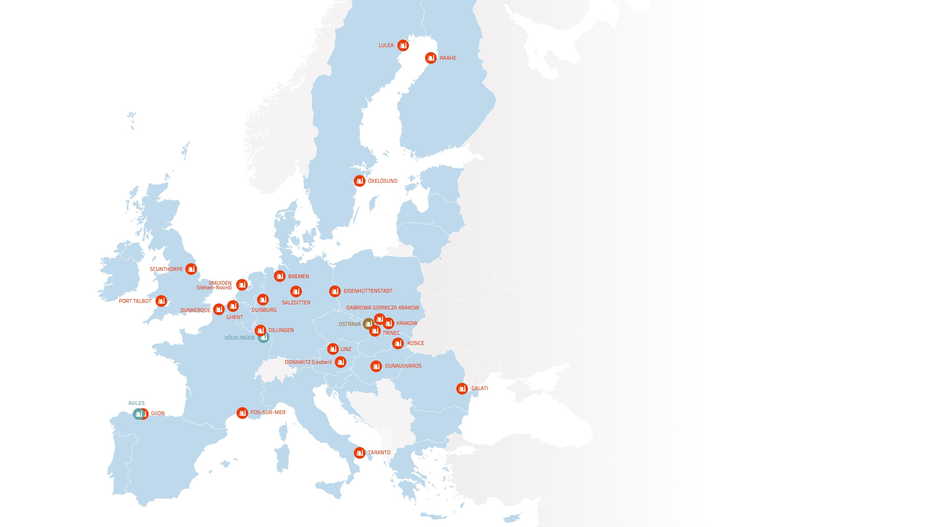
Map of EU steel production sites
Blast Furnace – Basic Oxygen Furnace
Location | Hot Metal Capacity ('000 tonnes/ year) | Finished Steel Capacity ('000 tonnes/ year) | No. of furnaces
AUSTRIA
DONAWITZ (Leoben) | 1370 | 1570 | 2
LINZ | 4340 | 6000 | 3
BELGIUM
GHENT | 4430 | 5000 | 2
CZECH REPUBLIC
OSTRAVA | 3200 |  | 3 – BF only
TRINEC | 2100 | 2400 | 2
FINLAND
RAAHE | 2400 | 2600 | 2
FRANCE
DUNKERQUE | 6800 | 6750 | 3
FOS-SUR-MER | 5160 | 5100 | 2
GERMANY
BREMEN | 3960 | 3800 | 2
DILLINGEN | 4790 | 2760 | 2
DUISBURG | 11600 | 11560 | 4
EISENHÜTTENSTADT | 2340 | 2400 | 2
SALZGITTER | 4800 | 5200 | 3
VÖLKLINGEN |  | 3240 | BOF only
HUNGARY
DUNAUIJVAROS | 1310 | 1650 | 2
ITALY
TARANTO | 9590 | 11500 | 4
NETHERLANDS
IJMUIDEN (Velsen-Noord) | 6310 | 7500 | 2
POLAND
DABROWA GORNICZA | 4500 | 5000 | 2
KRAKOW | 1310 | 2600 | 1
ROMANIA
GALATI | 3250 | 3200 | 2
SLOVAKIA
KOSICE | 2850 | 4500 | 2
SPAIN
AVILES |  | 4200 | BOF only
GIJON | 4480 | 1200 | 2
SWEDEN
LULEA | 2200 | 2200 | 1
ÖXELÖSUND | 1800 | 1700 | 2
UNITED KINGDOM
PORT TALBOT | 4770 | 4900 | 2
SCUNTHORPE | 3590 | 3200 | 3
Blast Furnace & Basic Oxygen Furnace
Blast Furnace only
Basic Oxygen Furnace only

Slide 3
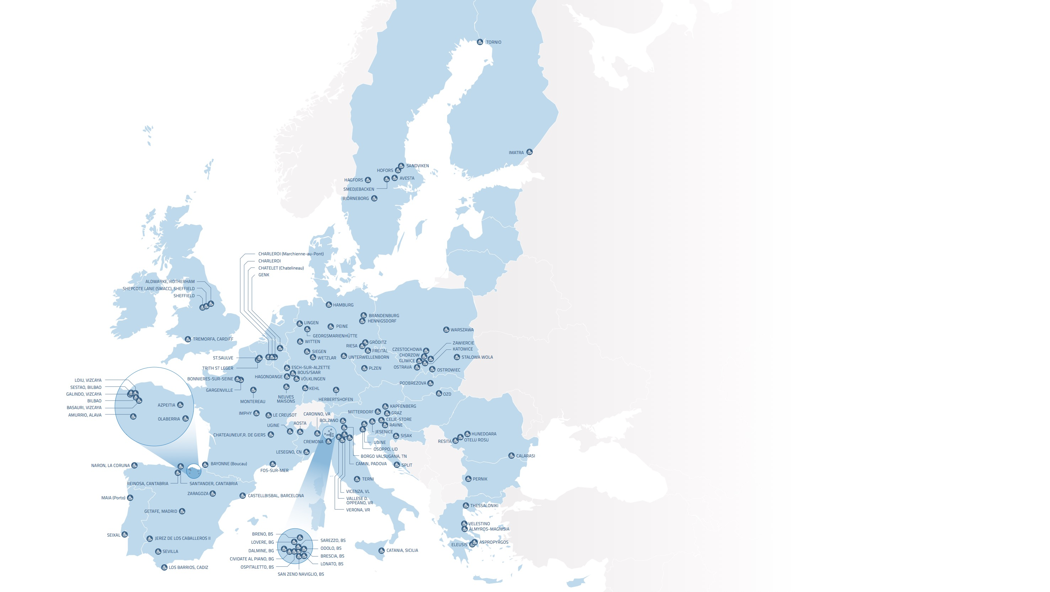
Map of EU steel production sites
Electric Arc Furnace
Location | Capacity ('000 tonnes/ year) | No. of furnaces
AUSTRIA
GRAZ | 365 | 1
KAPFENBERG | 180 | 1
MITTERDORF | 300 | 1
BELGIUM
CHARLEROI | 850 | 1
CHARLEROI (Marchienne-au-Pont) | 350 | 1
CHATELET (Chatelineau) | 1000 | 1
GENK | 1200 | 2
BULGARIA
PERNIK | 1000 | 2
CROATIA
SISAK | 350 | 1
SPLIT | 185 | 1
CZECH REPUBLIC
OSTRAVA | 120 | 1
PLZEN | 150 | 2
FINLAND
IMATRA | 360 | 1
TORNIO | 1300 | 2
FRANCE
BAYONNE (Boucau) | 1200 | 1
BONNIERES-SUR-SEINE | 550 | 1
CHATEAUNEUF,R. DE GIERS | 100 | 1
FOS-SUR-MER | 480 | 1
GARGENVILLE | 700 | 1
HAGONDANGE | 460 | 1
IMPHY | 90 | 1
LE CREUSOT | 150 | 1
MONTEREAU | 720 | 1
NEUVES MAISONS | 800 | 1
ST.SAULVE | 730 | 1
TRITH ST LEGER | 800 | 1
UGINE | 250 | 2
GERMANY
BOUS/SAAR | 350 | 1
BRANDENBURG | 1800 | 2
FREITAL | 90 | 1
GEORGSMARIENHÜTTE | 1100 | 1
GRÖDITZ | 100 | 1
HAMBURG | 1100 | 1
HENNIGSDORF | 1000 | 2
HERBERTSHOFEN | 1180 | 2
KEHL | 2500 | 2
LINGEN | 620 | 1
PEINE | 1000 | 1
RIESA | 900 | 1
SIEGEN | 600 | 1
SIEGEN | 150 | 1
UNTERWELLENBORN | 1100 | 1
VÖLKLINGEN | 300 | 1
WETZLAR | 400 | 1
WITTEN | 480 | 1
Location | Capacity ('000 tonnes/ year) | No. of furnaces
GREECE
ALMYROS-MAGNISIA | 1200 | 1
ASPROPYRGOS | 400 | 1
ELEUSIS | 800 | 1
THESSALONIKI | 600 | 1
VELESTINO | 450 | 1
HUNGARY
OZD | 400 | 1
ITALY
AOSTA | 260 | 1
BOLZANO | 200 | 2
BORGO VALSUGANA, TN | 600 | 1
BRENO, BS | 100 | 1
BRESCIA, BS | 1200 | 2
BRESCIA, BS | 650 | 1
CAMIN, PADOVA | 600 | 1
CARONNO, VA | 780 | 1
CATANIA, SICILIA | 500 | 1
CIVIDATE AL PIANO, BG | 250 | 1
CREMONA | 3850 | 2
DALMINE, BG | 700 | 1
LESEGNO, CN | 600 | 1
LONATO, BS | 1100 | 1
LONATO, BS | 600 | 1
LOVERE, BG | 150 | 1
ODOLO, BS | 900 | 1
OSOPPO, UD | 2200 | 1
OSPITALETTO, BS | 150 | 1
SAN ZENO NAVIGLIO, BS | 800 | 1
SAREZZO, BS | 540 | 1
TERNI | 1450 | 2
UDINE | 500 | 1
UDINE | 770 | 1
VALLESE D. OPPEANO, VR | 450 | 1
VERONA, VR | 1250 | 2
VICENZA | 170 | 1
VICENZA, VL | 1200 | 1
LUXEMBOURG
ESCH-SUR-ALZETTE | 2250 | 2
POLAND
CHORZOW | 145 | 1
CZESTOCHOWA | 800 | 1
GLIWICE | 250 | 1
KATOWICE | 65 | 1
OSTROWIEC | 900 | 1
STALOWA WOLA | 240 | 1
WARSZAWA | 750 | 1
ZAWIERCIE | 1340 | 2
PORTUGAL
MAIA (Porto) | 600 | 1
SEIXAL | 1100 | 1
Location | Capacity ('000 tonnes/ year) | No. of furnaces
ROMANIA
CALARASI | 470 | 1
HUNEDOARA | 550 | 1
OTELU ROSU | 830 | 1
RESITA | 450 | 1
SLOVAKIA
PODBREZOVA | 350 | 1
SLOVENIA
CELJE-STORE | 150 | 1
JESENICE | 500 | 1
RAVNE | 140 | 1
SPAIN
AMURRIO, ALAVA | 150 | 1
AMURRIO, ALAVA | 360 | 1
AZPEITIA | 800 | 1
BASAURI, VIZCAYA | 740 | 1
BILBAO | 1100 | 1
CASTELLBISBAL, BARCELONA | 2400 | 2
GALINDO, VIZCAYA | 400 | 1
GETAFE, MADRID | 600 | 1
JEREZ DE LOS CABALLEROS II | 1300 | 1
LOIU, VIZCAYA | 130 | 1
LOS BARRIOS, CADIZ | 1200 | 3
NARON, LA CORUNA | 700 | 1
OLABERRIA | 2450 | 1
REINOSA, CANTABRIA | 240 | 1
SANTANDER, CANTABRIA | 750 | 1
SESTAO, BILBAO | 2000 | 2
SEVILLA | 1300 | 2
ZARAGOZA | 500 | 1
SWEDEN
AVESTA | 500 | 1
BJÖRNEBORG | 95 | 1
HAGFORS | 120 | 1
HOFORS | 500 | 1
SANDVIKEN | 200 | 1
SMEDJEBACKEN | 480 | 1
UNITED KINGDOM
ALDWARKE, ROTHERHAM | 1220 | 2
SHEFFIELD | 150 | 1
SHEPCOTE LANE (SMACC), SHEFFIELD | 500 | 1
TREMORFA, CARDIFF | 1200 | 1
Electric Arc Furnace

Slide 4
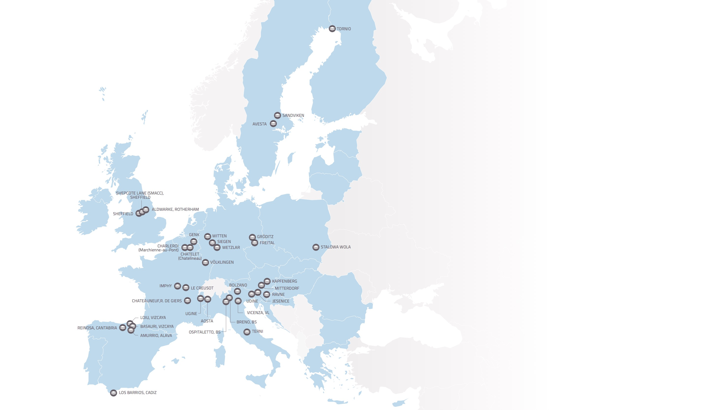
Map of EU steel production sites
Stainless Steel Specialty
Location | Capacity ('000 tonnes/ year) | No. of furnaces
AUSTRIA
KAPFENBERG | 180 | 1
MITTERDORF | 300 | 1
BELGIUM
CHARLEROI (Marchienne-au-Pont) | 350 | 1
CHATELET (Chatelineau) | 1000 | 1
GENK | 1200 | 2
FINLAND
TORNIO | 1300 | 2
FRANCE
CHATEAUNEUF,R. DE GIERS | 100 | 1
IMPHY | 90 | 1
LE CREUSOT | 150 | 1
UGINE | 250 | 2
GERMANY
FREITAL | 90 | 1
GRÖDITZ | 100 | 1
SIEGEN | 600 | 1
SIEGEN | 150 | 1
VÖLKLINGEN | 300 | 1
WETZLAR | 400 | 1
WITTEN | 480 | 1
ITALY
AOSTA | 260 | 1
BOLZANO | 200 | 2
BRENO, BS | 100 | 1
OSPITALETTO, BS | 150 | 1
TERNI | 1450 | 2
UDINE | 500 | 1
VICENZA | 170 | 1
POLAND
STALOWA WOLA | 240 | 1
SLOVENIA
JESENICE | 500 | 1
RAVNE | 140 | 1
SPAIN
AMURRIO, ALAVA | 150 | 1
BASAURI, VIZCAYA | 740 | 1
LOIU, VIZCAYA | 130 | 1
LOS BARRIOS, CADIZ | 1200 | 3
REINOSA, CANTABRIA | 240 | 1
SWEDEN
AVESTA | 500 | 1
SANDVIKEN | 200 | 1
UNITED KINGDOM
ALDWARKE, ROTHERHAM | 1220 | 2
SHEFFIELD | 150 | 1
SHEPCOTE LANE (SMACC), SHEFFIELD | 500 | 1
Stainless Steel Specialty

